Slide 1
Mitigating Model Specification Risk in Reserving, Metrics for IFRS 17, Correlations and Drivers, Capital Allocation and SII One-Year Risk Horizon
Talk given by Dr. Ben Zehnwirth to the Actuarial Society of Hong Kong
Wednesday August 28, 2019

Slide 2
Outline
What makes a good model?
Four parts:
Part 1: Developing a model which describes the data and provides metrics needed for IFRS 17- mitigating model specification risk
Part 2: Metrics needed by IFRS 17 and additional considerations
Part 3: Distinguishing correlations, common drivers and spurious correlations
Part 4: Risk capital allocation, One-year reserve risk, Solvency II one year risk horizon

Slide 3
Summary – Part One
Modeling frameworks necessary for IFRS 17
What makes a good model?
Regression formulation of standard link ratio methods and extensions – The Extended Link Ratio Family (ELRF) modeling framework includes Mack, Murphy & much more
Model assumptions must be explicit, interpretable, testable, and related to past trends and volatility
The impact of inflation: social and economic
Probabilistic Trend Family [PTF] and the Multiple Probabilistic Trend Family [MPTF] modeling frameworks and critical metrics needed for IFRS 17
Bootstrap technique – not a model, but a powerful diagnostic tool

Slide 4
What makes a good model?
Good models are reversible
What makes a good model?
A stochastic model, or more generally any model that takes account of the statistical variability in the data should be reversible, in the sense that the model can be used to generate simulated data with the same statistical properties as the original data
The bootstrap method is a natural choice for simulation from any stochastic model
A probabilistic model for which probability distributions are central to the model structure also affords a direct route to simulation
In either case, the goal is that real and simulated data should be indistinguishable, from an EDA point of view

Slide 5
Variability and Uncertainty
What makes a good model?
These are different concepts; they are not interchangeable and need to be clearly distinguished in the model structure.
“Variability is a phenomenon in the physical world to be measured, analyzed and where appropriate explained. By contrast uncertainty is an aspect of knowledge.”
  - Sir David Cox

Slide 6
Example: Coin vs Roulette Wheel
What makes a good model?
Coin
100 tosses fair coin (#H?)
Mean = 50
Std Dev = 5
CI [50,50]
"Roulette Wheel"
No. 0,1, …, 100
Mean = 50
Std Dev = 29
CI [50,50]
1
0
1
…
0
0
In 95% of experiments with the coin the number of heads will be in interval [40,60].
In 95% of experiments with the wheel, observed number will be in interval [2, 97].
Where do you need more risk capital?
Now introduce uncertainty into your knowledge - if coin or roulette wheel are ‘out of true’ then conclusions must be based on observed data

Slide 7
ELRF (Extended Link Ratio Family) Modeling Framework
Regression formulation of standard link ratio methods and extensions
A regression formulation of link ratios and extensions. This includes stochastic methods, Mack, Murphy etc.
x is cumulative at dev. j-1 and y is cumulative at dev. j
Link Ratios are a comparison of columns
We can graph the ratios of Y:X - line through O?
j-1
j
y
X = Cum. @ j-1
Y = Cum. @ j
y/x
y
y/x
y
x
x
x
Using ratios => E(Y|x) = bx

Slide 8





Weighted Least Square Regression
Regression formulation of standard link ratio methods and extensions
Case 1 – no weights:
Observed data: Number of pairs

Slide 9




Regression formulation of standard link ratio methods and extensions
Case 2 – introduce weights:

Slide 10



Different choices for the weight parameter delta produce regression formulations of different methods
Regression formulation of standard link ratio methods and extensions
(Mack Method)
Volume Weighted Average
Arithmetic Average
Volume Square Weighted Average

Slide 11
Intercept (Murphy (1994))
Regression formulation of standard link ratio methods and extensions
Since y already includes x: y = x + p, i.e. p = y - x
Incremental Cumulative
at j at j -1
Is b -1 significant ? Venter (1996)

Slide 12
When the ratio has no predictive power we can use the intercept only
Regression formulation of standard link ratio methods and extensions
Cumulative
Incremental
p
j-1 j
j-1 j
} p
x
x
x
x
x
x
x
Link ratio b has no predictive power

Slide 13
Is assumption E(p | x ) = a + (b-1) x tenable?
Regression formulation of standard link ratio methods and extensions
Note: If corr(x, p) = 0, then corr((b-1)x, p) = 0
If x, p uncorrelated, no link ratio has predictive power
Ratio selection by actuarial judgment can’t overcome zero correlation.
Corr. often close to 0
Sometimes not
  Does this imply ratios are a good model?
  Ranges?
p
x

Slide 14
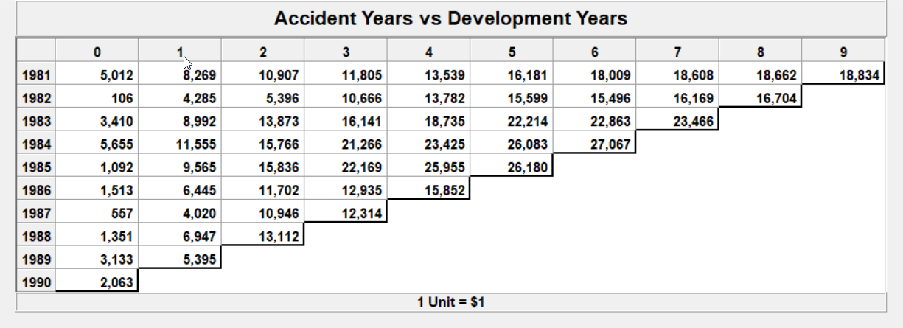
Incurred data modelled by Mack (1994), and thereafter ad nauseum using link ratios and extensions thereof

Slide 15
Residuals and Diagnostics
Model assumptions – testing the selected model
Regression formulation enables the computation of weighted standardised residuals – hence can be compared across periods.
Mack (equivalently, volume weighted average) weighted standardized residuals for IL(C) data
Note trend in residuals versus fitted values (bottom right). The model overfits big values, under fits small values

Slide 16
More diagnostics
Model assumptions – testing the selected model
In this example intercepts are needed - best link ratios are not through origin- hence method over fits big values and under fits small values as seen in above residual graph. Also Y-X incremental versus X no correlation from period 0 to 1. This is true for all periods.

Slide 17
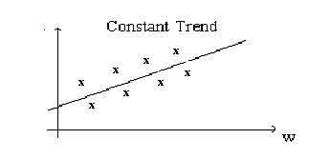
Regression formulation of standard link ratio methods and extensions
Extended Link Ratio Family (ELRF) Modeling Framework
Cumulative
Incremental
j-1 j
j-1 j
90
} p
91
92
w
p
Condition 1:
x
x
x
x
x
x
x
x
w
Condition 2:

Slide 18
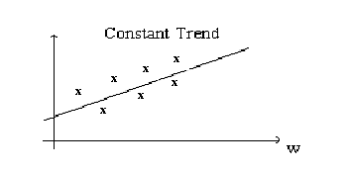
Introduce a trend parameter for uniform accident year effects
Regression formulation of standard link ratio methods and extensions
As long as there is one unchanging trend this will suffice for modeling calendar year trends as well.
p
p vs acci. yr, and previous cumulative

Slide 19
Mack=Chain Ladder (volume weighted average) treats accident years like development years and vice versa
Can cumulate across or down. Same result each way.
Dev per
ratios across
project across
1:
incremental
array
cumulate across
Acci per
Dev per
ratios down
project down
2:
cumulate down
Acci per

Slide 20
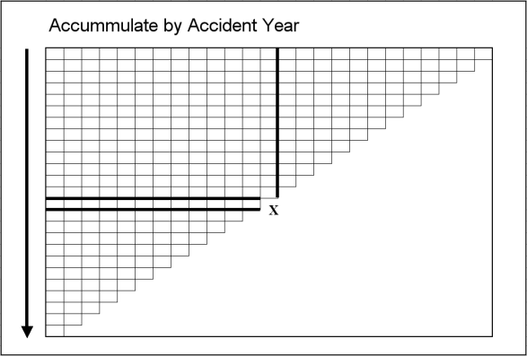
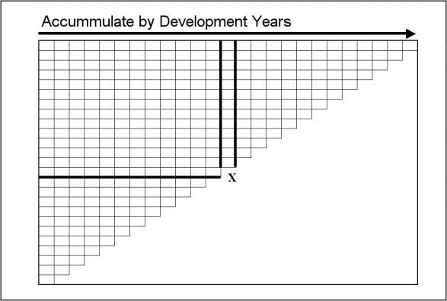
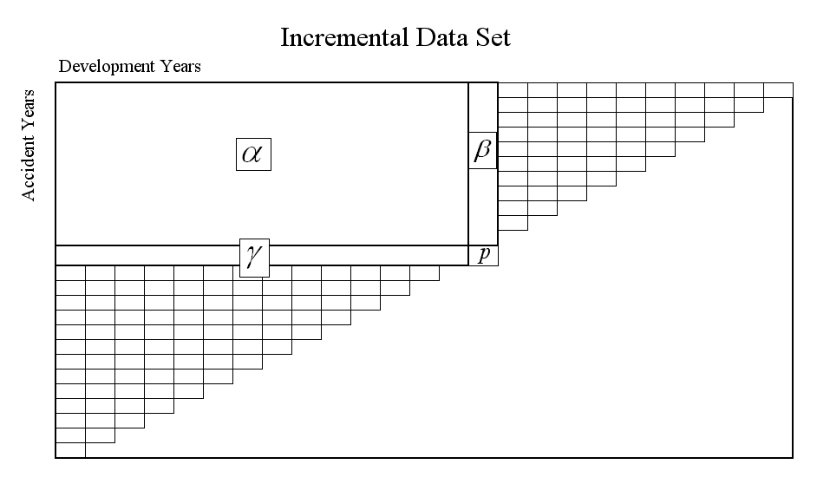
Mack does not distinguish between accident years and development years. Below is a simple proof.
The standard deviations are different because of different conditioning

Slide 21
Dataset ABC- Worker’s Comp large company- Dev. Period structure is not same as Acci. Period structure
Data versus development year
Data versus accident year
Very different structure. So CL (Mack) ignores this salient information.

Slide 22
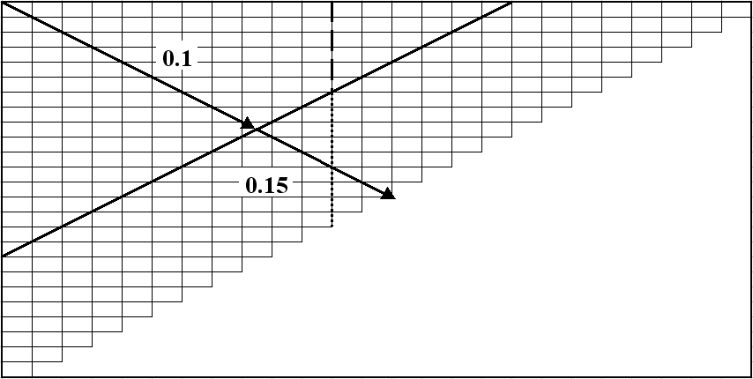


Regression formulation of standard link ratio methods and extensions
Condition 3:
Incremental
Review 3 conditions:
Condition 1: Zero trend
Condition 2: Constant trend, positive or negative
Condition 3: Non-constant trend

Slide 23
Inflation: social and economic
The impact of inflation: social and economic
Inflation economic or social is a multiplicative calendar year effect on the dollar scale;
Inflation is an additive effect on the logarithmic scale.
Therefore
  Inflation does not change the CoV on a $ scale
  Inflation does not change the variance on a log scale.
That is,
  Need to consider distributions that are currency invariant;
  Need to consider distributions for which the mean changes on log scale but not the variance.
This rules out the Poisson distribution immediately!

Slide 24
The Probabilistic Trend Family (PTF) Modelling Framework
The Probabilistic Trend Family Modeling Framework
Trend axioms satisfied by every real incremental triangle
Trends occur in three directions:
Development year
0
1
d
Past
Future
2006
2007
t = w+d
2008
w
Accident year

Slide 25
The Probabilistic Trend Family (PTF) Modelling Framework
The Probabilistic Trend Family (PTF) modeling framework is described in the paper "Best Estimates for Reserves", published in the Proceedings of the CAS, Volume LXXXVII, 2000.
In the PTF modeling framework an optimal model is identified, equivalently, built or designed that captures the variability (volatility) in the incremental loss development array. The variability is described using four components of interest. Namely, trends in the three directions: development period, accident period and calendar period, and the variability of the data about the trend structure. The (process) variability is an integral part of the model.
A normal distribution is fitted to each cell on a log scale. The means of the distributions are related (described) by the trend structure.
Forecasts of distributions going forward are based on explicit auditable assumptions that are controllable by the actuary.

Slide 26
Same uniform decay for each accident year
0 1 2 3 4 5 6 7 8 9 10 11 12 13
100000 81873 67032 54881 44933 36788 30119 24660 20190 16530 13534 11080 9072 7427
100000 81873 67032 54881 44933 36788 30119 24660 20190 16530 13534 11080 9072
100000 81873 67032 54881 44933 36788 30119 24660 20190 16530 13534 11080
100000 81873 67032 54881 44933 36788 30119 24660 20190 16530 13534
100000 81873 67032 54881 44933 36788 30119 24660 20190 16530
100000 81873 67032 54881 44933 36788 30119 24660 20190
100000 81873 67032 54881 44933 36788 30119 24660
100000 81873 67032 54881 44933 36788 30119
100000 81873 67032 54881 44933 36788
100000 81873 67032 54881 44933
100000 81873 67032 54881
100000 81873 67032
100000 81873
100000
- 0.2d
d
alpha = 11.513
-0.2
PAID LOSS = EXP(alpha - 0.2d)

Slide 27
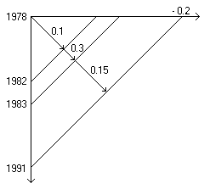
The Probabilistic Trend Family Modeling Framework
Trend axioms satisfied by every loss development array.
Calendar year trends project in the other two directions
0.15
0.3
0.1

Slide 28
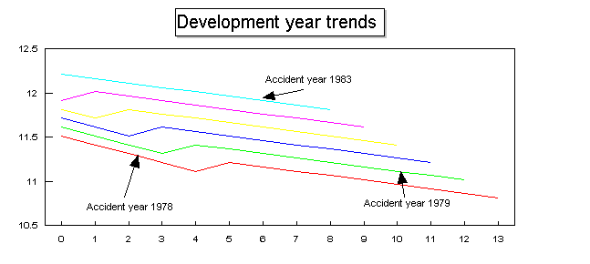
Resultant development year trends

Slide 29
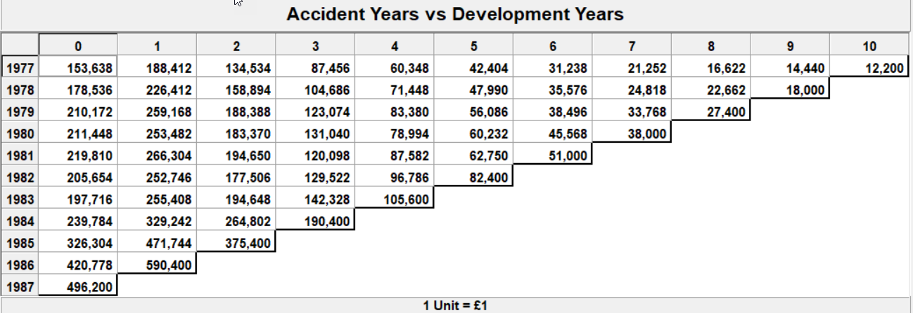
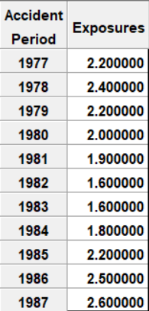
ABC Example-WC of a large comany

Slide 30
The structure of a Probabilistic Trend Family model
The Probabilistic Trend Family Modeling Framework
The optimal PTF identified model. Note the model fits a normal distribution to each cell. The means are related via the trend structure. ABC example.
Note major calendar year trend shift

Slide 31
Dataset ABC - Wtd Standardized Residuals of Mack method (Chain Ladder ratios)
The impact of inflation: social and economic
It is impossible for any link ratio method including Mack (=CL ratios) to capture and describe trends in any direction, let alone the calendar years where changing inflation trends (social/economic) are clearly evident.

Slide 32
The Bootstrap Technique: not a model but a powerful diagnostic tool
The bootstrap technique
"Bootstrapping utilizes the sampling-with-replacement technique on the residuals of the historical data", and
"Each simulated sampling scenario produces a new realization of ‘triangular data’ that has the same statistical characteristics as the actual data." (emphasis added)
- François Morin , Integrating Reserve Risk Models into Economic
Capital Models, CLRS Seminar, Washington D.C. 2008
This only true if the model has the same statistical features as the data!
Bootstrap samples are generated from a model

Slide 33
Bootstrap Samples
The bootstrap technique
Model
Bootstrap samples generated from model
Data
BS1
BS2
BS3
Real Data
…

Slide 34




Bootstrapped Dataset
The bootstrap technique
Data = Fit + residual
Working backwards from the bootstrapped residuals
we form a bootstrap dataset
Bootstrap sample = Fit + re-sample residual (scaled)

Slide 35
Bootstrap sample for a loss development array
The bootstrap technique
data = fit + residual
=
Bootstrap data = fit + resample
1
2
y
ŷ
r
resample whole array of “Std residuals”
r*
3
y*
ŷ
r*
Usually, r’s scaled to constant variance at step (2) then rescaled at step (3)

Slide 36
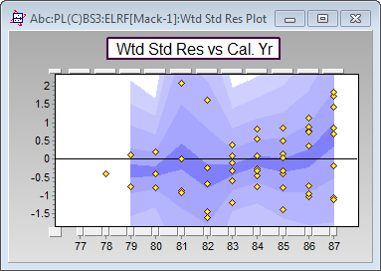
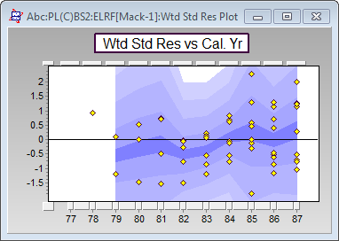
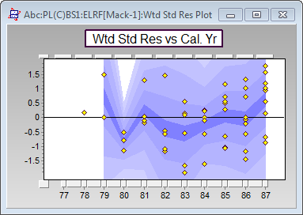
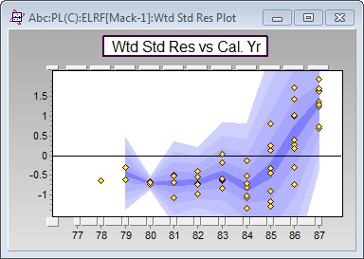
Mack and the bootstrap (Dataset ABC)
The bootstrap technique
Mack fitted to the real data (bottom-right) contains structure by calendar year
Bootstrap samples from the Mack method lose this structure as it has been randomized!
Data

Slide 37
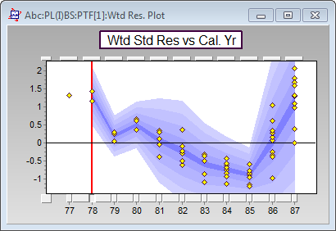
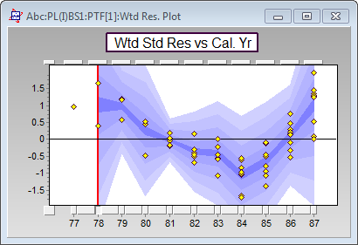
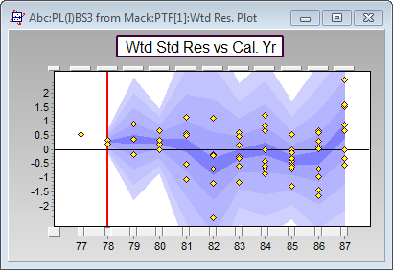
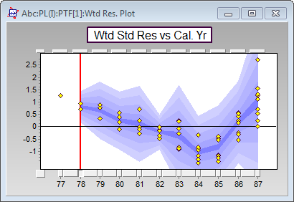
Mack bootstrap sample versus bootstrap samples from the identified PTF model (ABC data)
The bootstrap technique
Fitting all development and accident year trends to find what is remaining in the calendar years
applied to four datasets:
Real,
a Mack bootstrap sample, and
two bootstrap samples from the identified PTF model?
No prize for guessing the odd man out!

Slide 38
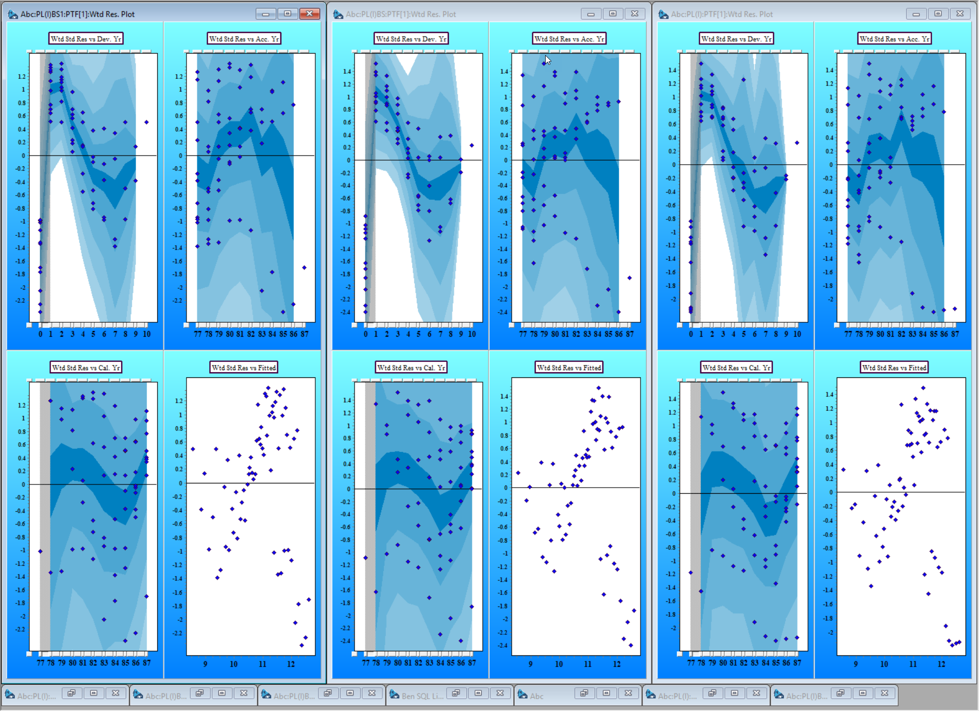
Residuals of fitting the model with a single parameter in each direction for three datasets: real and two BSs from the identified optimal PTF model
The bootstrap technique
Which display is the real data? Impossible to tell!

Slide 39
Summary: Part Two
IFRS 17
Cash flows
Risk Margins
Auditable Future assumptions
Onerous vs non-onerous vs potentially onerous
Earned vs unearned

Slide 40
The ELRF and PTF modelling frameworks, and IFRS 17
The Probabilistic Trend Family Modeling Framework
IFRS 17 requires:
  discounted cashflows by calendar year
  risk margins
  traceability between assumptions, especially inflation assumptions, from year to year
ELRF models can estimate an average calendar period trend, but you have no idea what it is or what the future inflation assumptions are!
Accurate assessment of cashflows, discounted cashflows, and auditable future inflation assumptions are only obtainable from the PTF modelling framework.
Solvency II one-year risk horizon also requires probability distributions of liability streams (cash flows) by calendar year and their correlations.

Slide 41
IFRS 17 For Insurance Contracts
IFRS 17 For Insurance Contracts
The Standard uses three different measurement approaches:
1. The Building Block Approach (BBA) for long-term contracts
“Long-term” = greater than 12 months, hence this does not apply to the majority of normal P&C contracts.
2. The Premium Allocation Approach (PAA) for short-term contracts
The bulk of P&C contracts fall under the PAA, but since this is a simplification of the BAA, we need to study the BAA as well.
3. The Variable Fee Approach (VFA) for direct participating contracts
The VFA applies to annuities and other participating contracts. We shall not consider these.

Slide 42
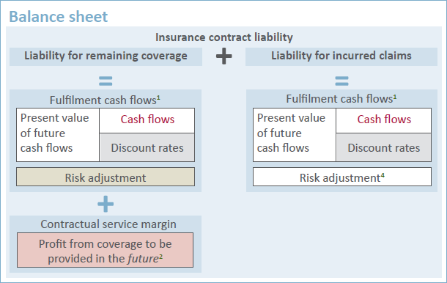
The Building Block Approach (BBA)
IFRS 17 For Insurance Contracts
Summary:
Cash flows recalculated to present value.
Separate treatment of incurred claims (expired premium) and future claims (unexpired premium).
Underwriting year as year of account is implied.
Risk adjustments required for both sides. (Unlike Solvency II, IFRS does not mandate a criterion for risk capital.)
Notes 1: The fulfilment cash flows are at current value; cash flows, discount rates and risk adjustment are updated at each
reporting date.
  4: The release of risk adjustment within the liability for incurred claims reduces incurred claims in profit or loss.

Slide 43
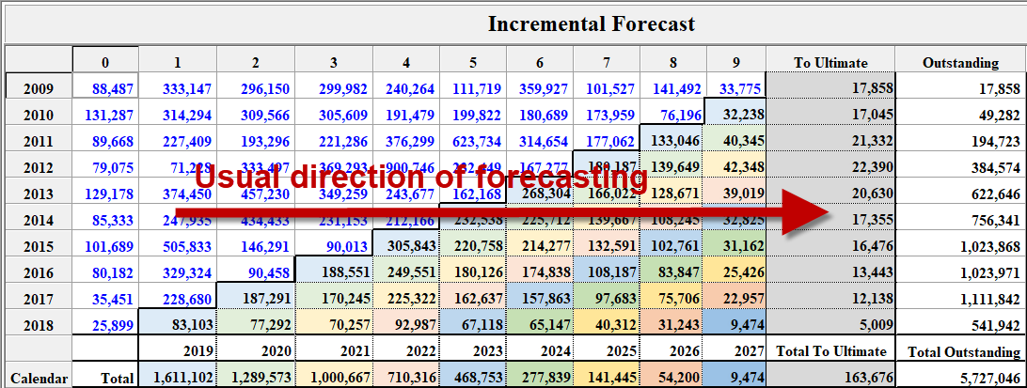
Sidebar 1: Modeling Future Cashflows
IFRS 17 For Insurance Contracts
The usual direction of forecasting is along accident years. Forecasts of payment streams are in the calendar direction, and must be projected by adding the relevant cells from the AY forecasts. The “to ultimate” adjustment is lumped together without consideration for run-off delays.

Slide 44
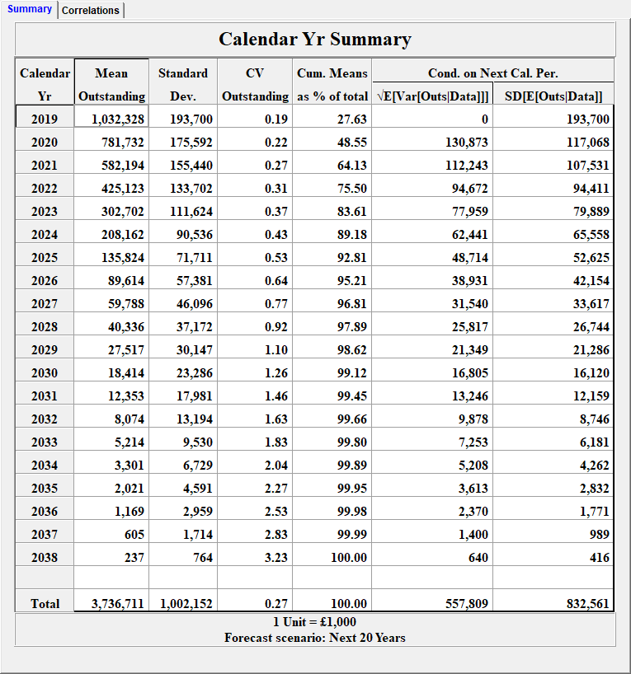
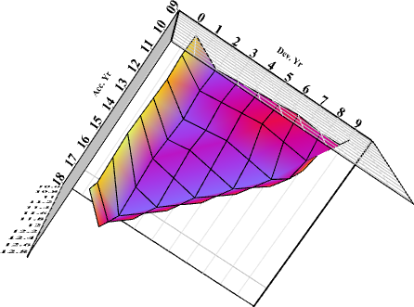
Sidebar 1: Modelling Future Cashflows (cont’d)
IFRS 17 For Insurance Contracts
3-D model display
The advantages of a model paradigm in which the Accident, Development and Calendar time-scales are given equal consideration, and where forecasts can be extended for into the future become much more salient under IFRS 17.

Slide 45
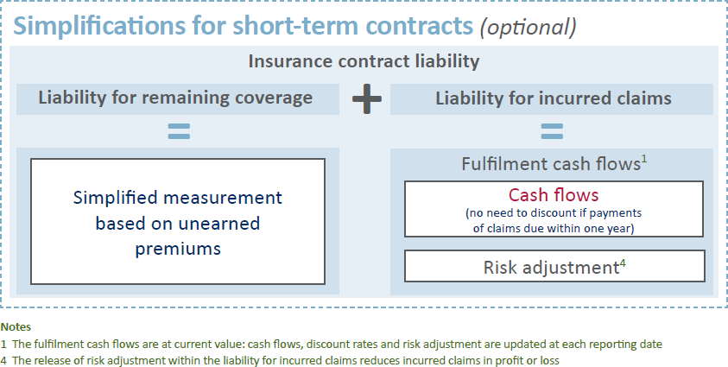
The Premium Allocation Approach (PAA)
IFRS 17 For Insurance Contracts
Discounting still required on all but the shortest-tailed lines.
Calculation based on premium proportions used for remaining coverage.

Slide 46
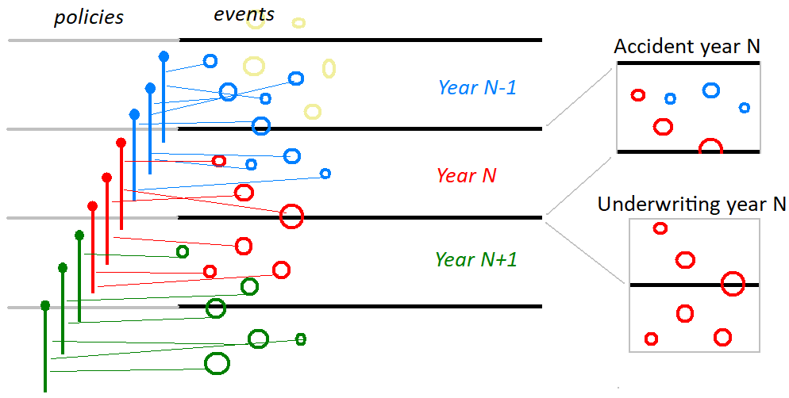
Underwriting Year vs Accident Year
IFRS 17 For Insurance Contracts
The events represent incurred claims, not all of which may have been reported before several years after the last policy has expired.
Accident year N contains events covered by policies from year N-1 and policies from year N.
Underwriting year N contains events occurring in year N and in year N+1

Slide 47
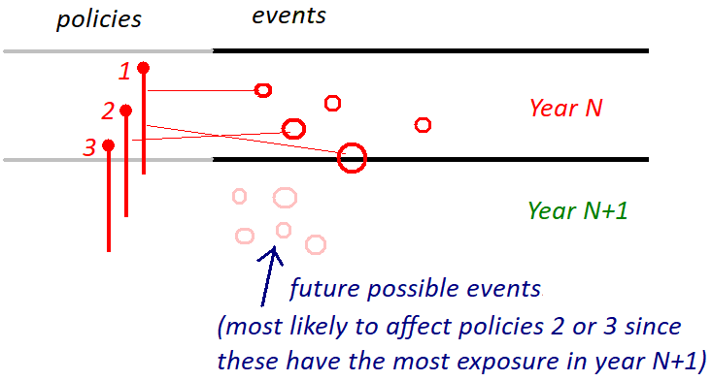
Unexpired Premium Reserve
IFRS 17 For Insurance Contracts
At the end of year N policy 1 has almost expired, but policies 2 and 3 are still in effect and will remain so for many months.
The best estimate of liabilities resulting from events that occurred in year N affecting policies 1, 2 or 3 forms the Expired Premium Reserve.
The estimate of liabilities from future events affecting policies 1, 2, or 3 is called the Unexpired Premium Reserve.
** Unexpired premium can be precisely calculated at any given date. It is a good proxy for total exposure to future events. **

Slide 48
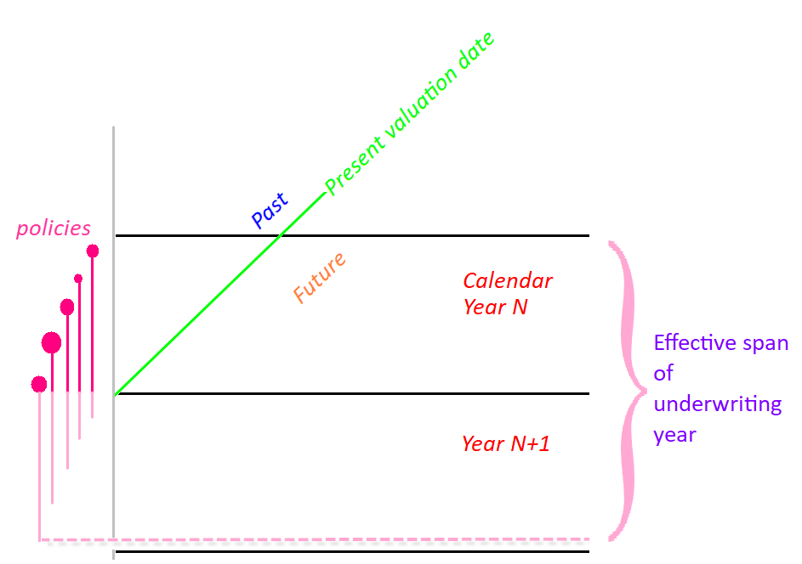
Underwriting Year
IFRS 17 For Insurance Contracts
The total of the premiums collected for the calendar (accounting) year forms the Written Premium (WP).
At the valuation date on or after the close of the year this can be precisely split into Earned Premium (EP) and Unearned (or Unexpired) Premium (UnP).

Slide 49
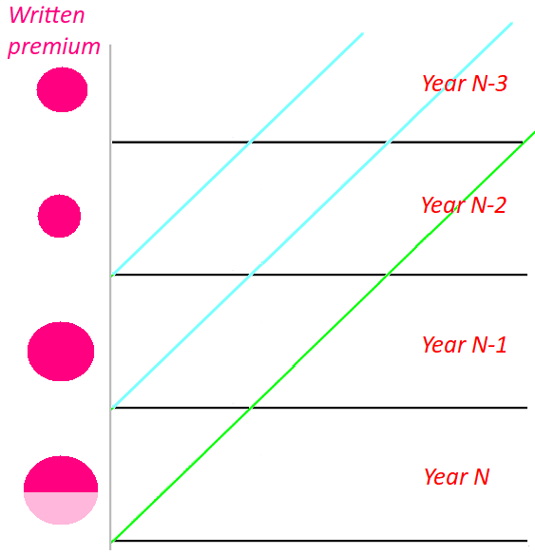
Ultimates by Underwriting year
IFRS 17 For Insurance Contracts
In respect of Underwriting Year (UwY) the loss arrays contain the aggregated claims attributable to policies written in the respective year as far as known on the valuation date.
WP is the natural exposure in this case, and forecasting on the basis of past experience enables estimation of ultimates, even for the current year for which a good proportion of the premium is unexpired.
The Loss Ratio is correctly calculated as Ultimate/WP. Note that Loss Ratio can only be estimated on an accident year basis, since it is not clear what the Premium should be.

Slide 50
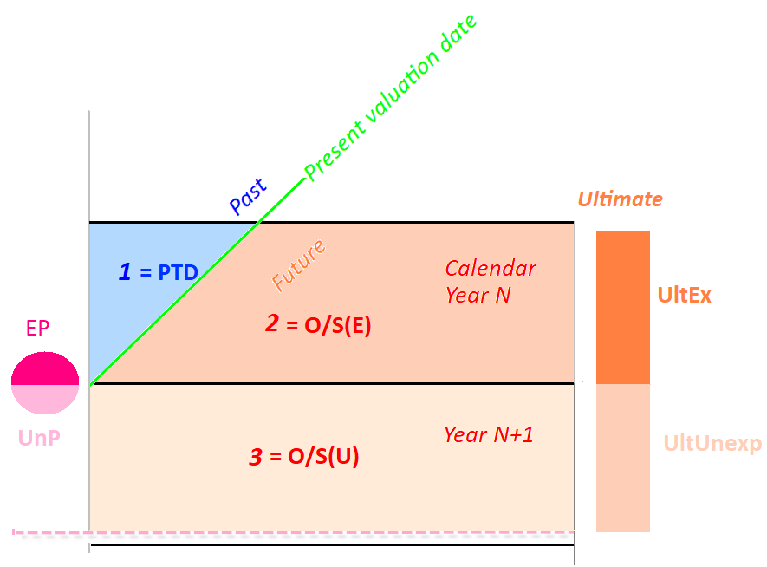
Outstanding split by Earned/Unearned
IFRS 17 For Insurance Contracts
WP = EP + UnP
Ratio, r = EP/WP
Ultimate = UltEx + UltUnexp
UltEx = r*Ultimate
Ultimate = PTD + O/S
= PTD + O/S(E) + O/S(U)
PTD + O/S(E) = UltEx
= r*(PTD + O/S)
O/S(E) = r*(O/S) – (1-r)*PTD

Slide 51
Onerous vs potentially onerous vs non-onerous
IFRS 17 For Insurance Contracts
IFRS 17 requires summarization by the likelihood of a claim being onerous. There are three groupings:
Onerous
Potentially onerous
Non-onerous
The likelihood of a claim being onerous is defined at the claims level.
Need break down of cash flows, risk margin allocations, auditable assumptions for each category
The Multiple Probabilistic Trend Family (MPTF) modeling framework can be used to provide the breakdown into these three groups (and/or any other summarization a company requires).

Slide 52
Sidebar 2: Risk Capital by Underwriting Year
IFRS 17 For Insurance Contracts
Risk capital is provisioned to offset future losses over and above current best estimates.
These losses are incurred via contracts already written and so naturally include those that belong to the unearned portion of such contracts.
The amount of Risk Capital required to be held is calculated based on the historical volatility in payments, as a multiple of the Standard Deviation, or as Value at Risk or Tail Value at Risk, at a given percentile.
The relevant forecasts for assessing Risk Capital are those based on the ‘Ultimate Horizon’, that is the current underwriting year is not split into earned and unearned fractions.

Slide 53
Summary: Part Three
Volatility Correlations versus Accident year and calendar year Drivers
One year ahead statistics(CDR)
  Variation in mean ultimates one year hence
  Risk Margin required for IFRS 17 and Solvency II
The Multiple Probabilistic Trend Family (MPTF) Modelling Framework

Slide 54
Is this correlation?
Correlation: what it is not

Slide 55
Correlations between LOBs
Correlations between LoBs
Three types of relationships
  Process correlation
  Parameter (trend) correlation
  Similar trend structure implying commonality in calendar year drivers and/or accident year drivers
Cannot measure these relationships unless LOB trend structure and process variability (volatility) modeled accurately
Most important direction is the calendar year
Reserve distribution correlation << Process correlation
Highest Process correlation we have seen is 0.6!
Highest Reserve distribution correlation is 0.2!

Slide 56
Correlations between LOBs
Correlations between LoBs
Take-Away points:
Most long tail LOBs exhibit zero correlation
Each company is different
Each LOB is different
Common accident year and calendar year drivers are stronger relationships than correlations
A single composite model for multiple LOBs/segments involves Seemingly Unrelated Regressions (SUR) – Zellner 1962
For 40 LOBs there are 780 pairwise correlations. Most are zero. We create clusters.

Slide 57
Correlations are in the volatility component of a model
Correlation – in the volatility
Two lines are (positively) correlated when their results tend to miss their target values in the same way.
This is what should concern business planners, because it affects the unpredictable component of the forecasts.
What is predicable when it includes common trend patterns, as in the above example, does not count towards correlation, because its effects are already incorporated into the model and forecast.

Slide 58
Correlations are in the volatility component of a model
Correlation – in the volatility
A forecast must include a volatility measure.
Without volatility, correlation cannot be measured. Calculating correlation requires a distribution.
In order to compute the volatility correlation between two LoBs, first one needs to identify the optimal PTF model for each LoB.
Fully-described loss distribution is ideal. But require, as a minimum, the mean and standard deviation (2nd moment) to calculate linear correlation.

Slide 59
Common accident year and common calendar year drivers
Common drivers are not correlation
Common drivers are a stronger influence than correlation.
Not typically found outside related losses.
For example, Gross versus Net of Reinsurance.
  Net of Reinsurance is a subset of Gross so common drivers are expected.
  Layers are subsets of ground up losses
  Segments of the same line.
  In this respect, detection of common drivers is as important as understanding correlations.
The two effects must be correctly distinguished and adjusted for as management strategies of these risk components differ.

Slide 60
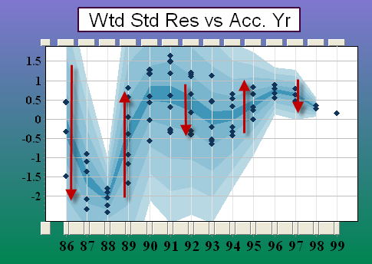
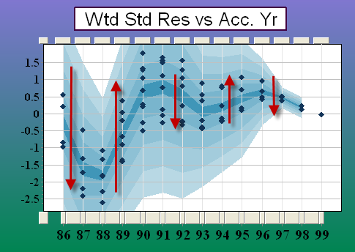
Common accident year drivers: SAD and SAM
Common drivers are not correlation
SAD
SAM
A model which does not take into account the changes in accident year levels shows a marked similarity in the fluctuations of residuals in the accident direction.
This is not correlation!

Slide 61
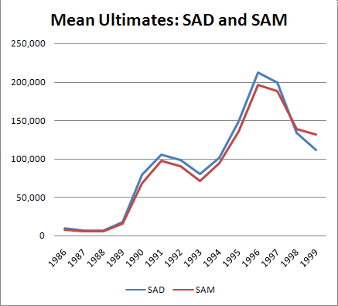
Spurious correlation
Common drivers are not correlation
This is not correlation

Slide 62
Layers Lim1M, Lim2M and 1Mxs1M; Lim2M=Lim1M+1Mxs1M
Common drivers are not correlation
The trend structure is the same for each layer (Left to right 1M, 1Mxs1M, 2M)

Slide 63
Layers Lim1M, Lim2M and 1Mxs1M; Lim2M=Lim1M+1Mxs1M
Common drivers are not correlation
Very high process correlations (Left to right 1M, 1Mxs1M, 2M)

Slide 64
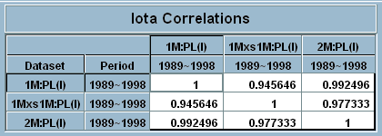
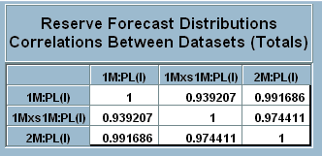
Layers Lim1M, Lim2M and 1Mxs1M; Lim2M=Lim1M+1Mxs1M
Common drivers are not correlation
Tables of process correlations (linear) and calendar year parameter correlations (linear)
This type of equivalent trend structure and high parameter and process correlations has not been observed for two LOBs

Slide 65
Spurious correlation
Spurious correlation
Two LOBs are simulated independently, each with its own unique trend structure.
One LOB has a calendar year trend of 10%, the other of 20%. Each has a -30% development year trend.
A correct model of the underlying data process would recognise that each LOB has a separate trend for each direction and a process correlation of zero - since this is how the data were generated.
If an incorrect model is used, one that does not describe the calendar year trends, then a spurious correlation would be detected, as an artefact of unaccounted-for structure in the data.

Slide 66
Spurious correlation
Spurious correlation
LOB 1
LOB 2
Correct model picks up true calendar year trend; process correlation is zero!

Slide 67
Spurious correlation
Spurious correlation
LOB 1
LOB 2
Incorrect model fails to pick up calendar trend; measures 98% correlation!
But this is not correlation since each sample is not random. They have structure.

Slide 68
Why spend so much time on what is not correlation?
Spurious correlation
Link ratio methods are widely used in the industry
Link ratio methods do not capture calendar year trends accurately
Correlations in the industry, if based on Link Ratio methods, highly likely to be spurious
Taking industry correlations and applying them to your individual company almost certainly result in higher risk margins that required

Slide 69
A Tale of Two LOBs: LOB1 and LOB3
Common calendar year drivers – an example
LOB 1
LOB 3
(Actually same line, different territories)
Both LOBs had a calendar year trend change in 2000
That should have been of concern!

Slide 70
A Tale of Two LOBs: LOB1 and LOB3
Common calendar year drivers – an example
LOB 1
LOB 3
Full model display
Trends in each direction and variance of normal distributions

Slide 71
A Tale of Two LOBs: LOB1 and LOB3
Common calendar year drivers – an example
Volatility correlation = Process correlation = 0.35 = Correlation in
normal distributed residuals
LOB1
LOB3
Note 98-00 common negative trend, 00-02 common positive trend
and 02-03 zero trend for LOB1 and negative trend LOB3.

Slide 72
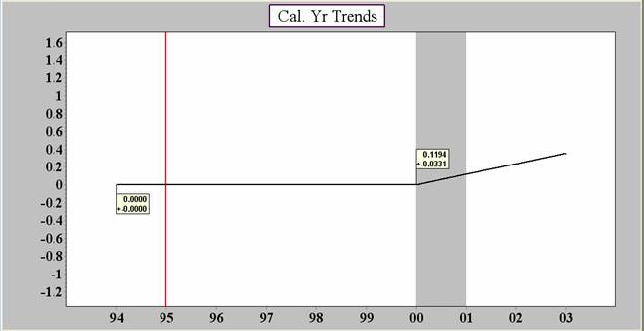
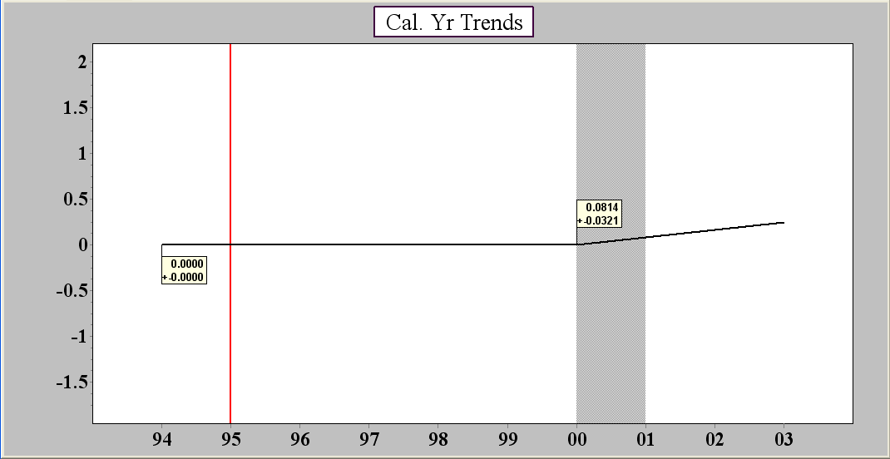
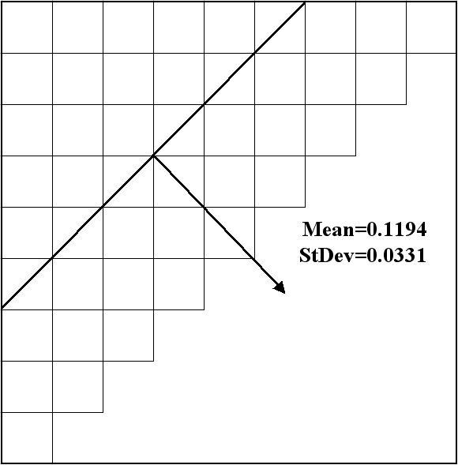

Model Displays for LOB1 and LOB3 for Calendar Years
Common calendar year drivers – an example

Slide 73
Reserve distribution correlations between two distinct LOBs – a very different story
Correlations in the reserve distribution
Highest process correlation observed between two different LOBs is about 0.6 (in our experience)
But Reserve distribution correlation is typically lower.
Trend structures for two LOBs typically different
Parameter correlations low or zero
See Private Passenger Automobile (PPA) versus Commercial Auto Liability (CAL)

Slide 74
Correlations and Other Relationships
Correlations and other relationships
There are five types of relationships.
#1 Process Correlation between two sets of (random) residuals
#2 Parameter Correlation
#3 Same Trend Structure - Common calendar year drivers. This is stronger than correlations.
#4 Common Accident-Year Drivers - Major implications for pricing future accident years. This relationship is also stronger than correlations.
#5 Reserve Distribution Correlations by total, accident years and calendar years.
The optimal single composite model may also involve cross dataset parameter constraints

Slide 75
Correlations and Other Relationships
Correlations and other relationships
#1 induces #2.
#3 is the 'worst' kind of relationship you can have between two LOBs
  Very little, if any, risk diversification.
  For future calendar year trends, the two LOBs move together.
  i.e. trend changes in one LOB mean trend changes in the other LOB.
If two LOBs satisfy #3, then #1 and #2 are typically not far from 1.
#3 – Only ever observed between layers of the same LOB, between segments of the same LOB, and between net of reinsurance and gross data (of the same LOB).

Slide 76
Correlations and other relationships
#1, #2, #3 induce #5.
  #5 is typically much less than #1 in the absence of #3.
#4 results in mean ultimates by accident year moving synchronously.
  Relationship may be close to linear- this is stronger than correlations and has implications for pricing.
  Synchronous mean ultimates are already incorporated in the reserving model.
  Sometimes only one or two accident years move synchronously due to a major event like Katrina. The process correlation about the new levels (trends) is usually low.
You cannot measure the relationship between two LOBs unless you first identify the trend structure and process variability in each LOB.

Slide 77
Correlations and modeling frameworks summary
Only in the Probabilistic Trend Family (PTF) modelling framework can you
  Identify a parsimonious model that
  Separates the trend structure in the three directions from the process variability
  Obtain the full set of metrics required for IFRS 17
The data triangle (real data) is regarded as a sample path from the identified model that fits (different) normal distributions to each cell.
Simulated triangles from the identified good model are indistinguishable from the real data.

Slide 78
Summary: Part Four
One year ahead statistics(CDR)
  Variation in mean ultimates one year hence
  Risk Margins for IFRS 17 and Solvency II
Risk Capital Allocation
Economic Balance Sheet and Solvency II one year risk horizon metrics
See paper “Solvency Capital Requirement and the Claims Development Result”, by David Munroe, Ben Zehnwirth and Igor Goldenberg. British Actuarial Journal Vol. 23, 20-18

Slide 79
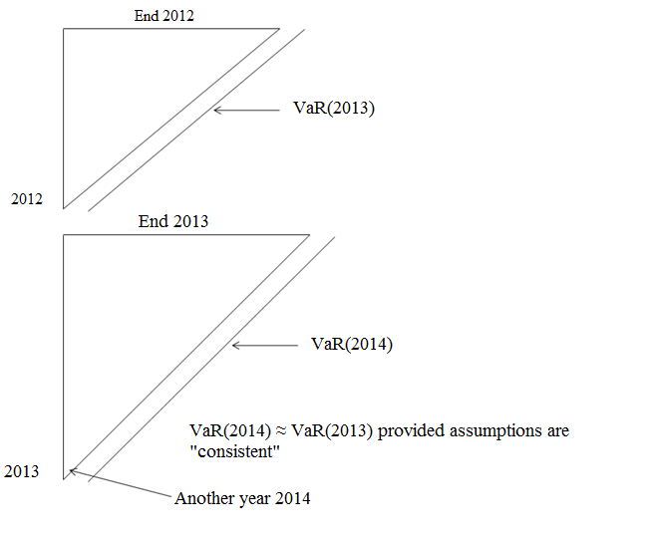
Updating, monitoring and the VMU (CDR)
What is the CDR? “Claims development result”

Slide 80
Peter England’s “CDR” is simply Var[E[Ult.|CY1]]
What is the CDR? “Claims development result”
When do estimates of prior year ultimates stay consistent on updating (next valuation period)?
With identified optimal parametric distribution models that are tested from the data, it is relatively straightforward to compute the CDR.
Note Pythagoras’s theorem:
Var[Ult.] =
E[Var[Ult.|CY1]] +
Var[E[Ult.|CY1]]
Analogous to One-Way ANOVA
Total SS =
Within Group SS +
Between Group SS

Slide 81
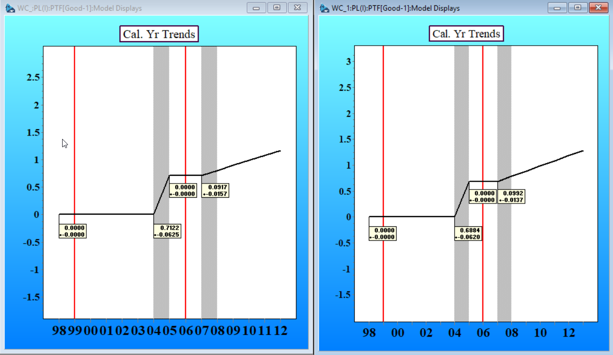
Consistent estimates of prior year ultimates and SII metrics

Slide 82
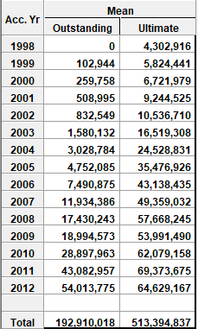
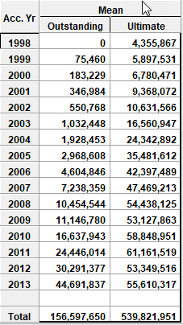
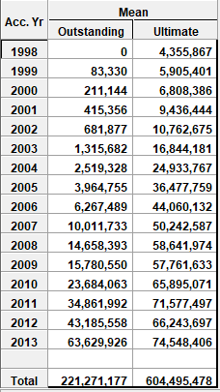
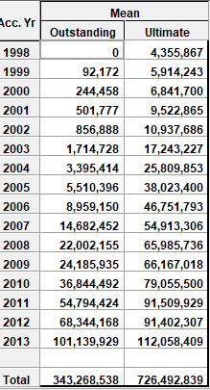
Consistent Estimates of prior year ultimates on updating
Consistent estimates of prior year ultimates and SII metrics
Original Forecast
On Updating
9% projected CY trend
0% projected CY trend
9% projected CY trend
20% projected CY trend
For forecast mean ultimates to be consistent you require a consistent model and consistent assumptions about the future.

Slide 83
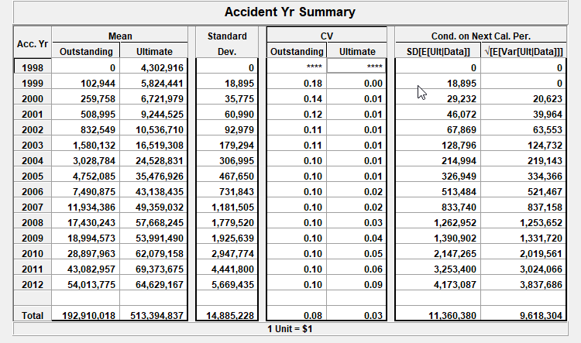
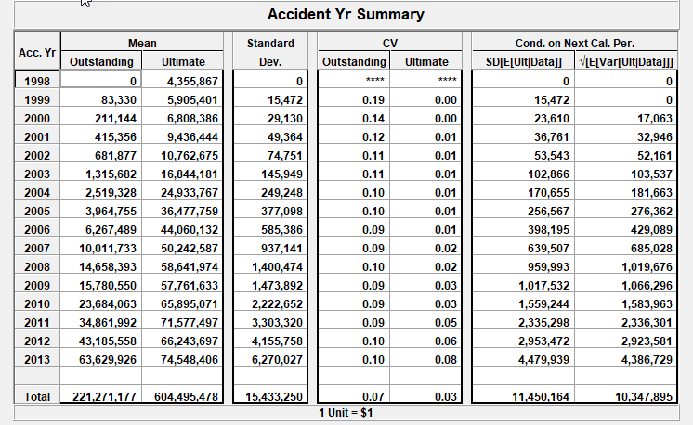
Consistent Estimates of prior year ultimates on updating
Consistent estimates of prior year ultimates and SII metrics
Notice: estimates increasing. Future CY trend 9%
At end 2012, Mean ultimate distribution 2012 = 64.6 and SD of ultimate distribution = 5.7
At end 2013, Mean ultimate distribution 2012 = 66.2 and SD of ultimate distribution = 4.2

Slide 84
Consistent Estimates of prior year ultimates on updating
Consistent estimates of prior year ultimates and SII metrics
SD of
variation in mean ultimate
Average change in ultimate SD
At end 2012, Mean ultimate distribution 2012 = 64.6 and SD of ultimate distribution = 5.7
At end 2013, Mean ultimate distribution 2012 = 66.2 and SD of ultimate distribution = 4.2

Slide 85
Risk Capital Allocation
Risk capital allocation
Assume Risk Capital at 98th percentile = 2 Standard Deviations
Risk Capital for Line A = $10m
Risk Capital for Line B = $15m
Aggregate Risk Capital (ARC) = $25m ?
Line A:
Res. $100m CV=5%
Line B:
Res. $50m CV=15%
Aggregate:
Res. $150m CV=?

Slide 86
Risk Capital Allocation
Risk capital allocation
Assume Risk Capital at 98th percentile = 2 Standard Deviations
Risk Capital for Line A = $10m
Risk Capital for Line B = $15m
Aggregate Risk Capital (ARC) = $25m ?
Line A:
Res. $100m CV=5%
Line B:
Res. $50m CV=15%
Aggregate:
Res. $150m CV=?
The answer depends on the correlation.
If Corr = +1.0, ARC = $25m
If Corr = 0.0 ARC = $18m

Slide 87
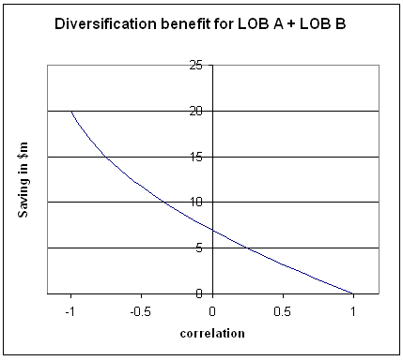
Risk Capital Allocation: Diversification benefit
Risk capital allocation
Benefit =
Sum of individual risk capital assessments – aggregate risk capital assessment from joint distribution of the two (correlated) lines.

Slide 88
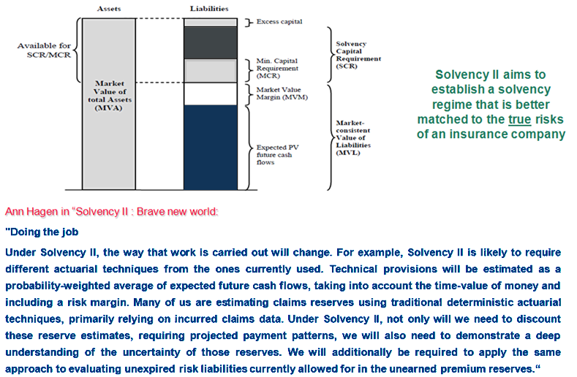
Solvency II – Economic Balance Sheet
Solvency II - Economic Balance Sheet

Slide 89
Solvency II one-year risk horizon:
Solvency II – One year risk horizon
satisfies 3 conditions
* decomposing the directives
* What are the basic elements?
Risk Capital is raised at the beginning of each year and any unused capital is released at the end of the year;
The analyses are conditional on the first (next) calendar year being in distress (99.5%);
At the end of the first year in distress, the balance sheet can be “restored” in such away that the company has sufficient technical provisions (fair value of liabilities) to continue business or to transfer the liabilities to another risk bearing entity.
An important consideration is that fungibility by calendar year is only in the forward direction

Slide 90
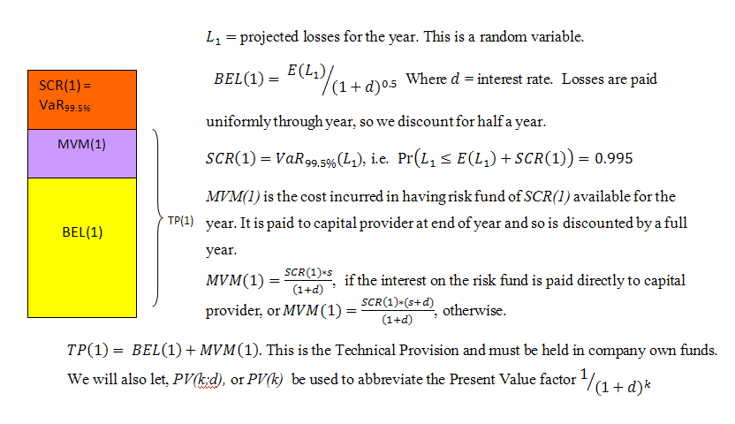
Risk Capital – One Year risk Horizon
Solvency II – One year risk horizon
Simplest Case: Only One Year Runoff

Slide 91
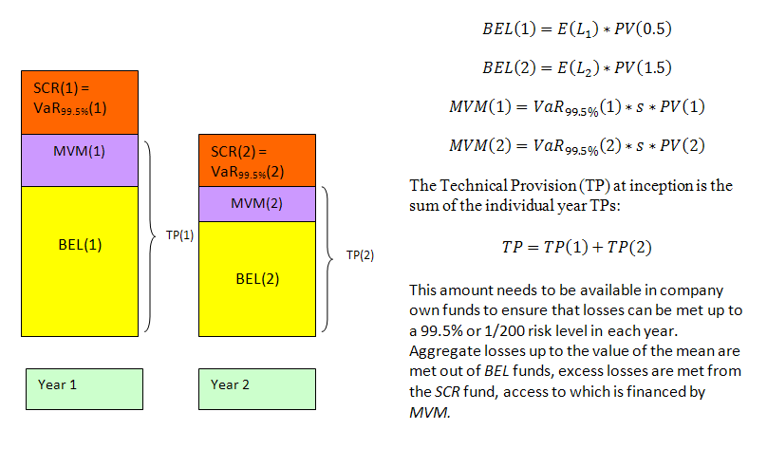
Risk Capital – One Year risk Horizon
Solvency II – One year risk horizon
Next Simplest Case: Two Year runoff, No correlation

Slide 92
Capital flow: Uncorrelated future calendar years
Solvency II – One year risk horizon
For losses exceeding the mean; surplus returned to capital provider
Risk Capital
Raised using MVM(1) in year 1
Risk Capital
Raised using MVM(2) in year 2
Risk
Capital (1)
Premium for risk capital; paid to capital provider
Risk
Capital (2)
MVM(1)
MVM(2+)
Technical Provision for year 2
BEL (2+)
MVM(2+)
Technical Provisions
Held by company
BEL (2+)
BEL(1)
Required Capital at Year 1
Required Capital at Year 2
For losses during year 1; surplus retained by company.

Slide 93

Risk Capital – One Year risk Horizon
Solvency II – One year risk horizon
Two-year picture of accounts: In year 1 we require reserves to meet paid loss liabilities for years 1 and 2 and we also need to able to fund the cost of access to the risk capital funds for years 1 and 2, however we only need access to the year 1 risk fund. When year 2 begins our accounts reset, since any cost over-runs from year 1 were paid out of the risk fund and do not degrade our prepared reserves for year 2. Provided the loss over-run is below RC(1) = VaR_{99.5}(L1).

Slide 94
Risk Capital – One Year risk Horizon
Solvency II – One year risk horizon
This is fine, except for one thing:
What if the distribution for the losses in year 2 has changed conditional on the losses in year one?
Simply put, the previous picture assumes there is no correlation between the distributions for years 1 and 2. In other words, whatever the outcome observed after year 1 we are going to remain fixed on our previous course, full steam ahead
Typically calendar year distributions are positively correlated.
The correlations are driven by parameter uncertainty.

Slide 95

Risk Capital – One Year risk Horizon
Solvency II – One year risk horizon
If year 1 is in distress at the 99.5th percentile, then our risk fund carries us over into year 2, but the conditional distributions are now different. Year 2 now must be re-evaluated in the light of conditional distributions and these increase the size of the BEL and the MVM, the cost of holding the risk fund. We need to include these adjustments in the year 1 risk fund

Slide 96
Two-year runoff with first year in distress
Solvency II – One year risk horizon
Let ξ = Year 1 in distress
VaR(1) is consumed.
MVM(1) = spread*SCR at year end (and returned along with risk free rate).
VaR(2|ξ) is raised in year 2.
ΔMVM(2)
Why is ΔMVM(2) disc by 1 year and MVM(2) by 2 years?
ΔBEL(2)
SCR
VaR_{99.5%}(1)
ΔMVM(2)
ΔBEL(2)
MVM(2)
VaR_{99.5%}(1)
SCR
MVM(1)
ΔVaR(2)
BEL(2)
MVM(1)=
spread*SCR*PV(1)
VaR_{99.5%}(2)
VaR(2|ξ)
TP
BEL(1)
BEL(1)
ΔMVM(2)
MVM(2|ξ)
TP(1)
MVM(2)
ΔBEL(2)
TP(2|ξ)
BEL(2)
BEL(2|ξ)
Inception
Year 1
Year 2 | ξ

Slide 97

N-year run-off (Correlated)
Solvency II – One year risk horizon

Slide 98
Questions?

